Slide 1
Temperature
Serious high fever
high fever
fever
normal
unnormal

Slide 2
1. Temperature
Eg1: The normal temperature of a healthy person is about 37 degree.
temperature (n)
Take sb’s temperature
Take the patient’s temperature
+Have a fever ( >37.50C) +have a high fever >< have a mild fever +Have a chill ( < 36.0C)
Chill (n)>< fever
Eg2: My grandfather had a high fever last night.
The nurses usually take the patient’s temperature in the morning

Slide 3
Strong/healthy >< ill/sick/tired
Healthy person >< sick person – patient
Rise ( v)= go up >< go down

Slide 4
A high fever/ a chill
when a person has a high fever : +apply cool water +give him medicine +take off some parts of his clothes. +give him an intravenous solution
when a person has a chill: +apply warm water +cover him with blanket/ clothes. +give him warm drinks

Slide 5
Question 1: what does the nurse use to take the patient’s temperature?
Question 2:Do sick people always have a fever?
Question 3: How often do you take a sick person’s temperature?
The nurse uses a thermometer to take the patient’s temperature
No, they don’t
We should take a sick person’s temperature at least 4 times a day

Slide 6
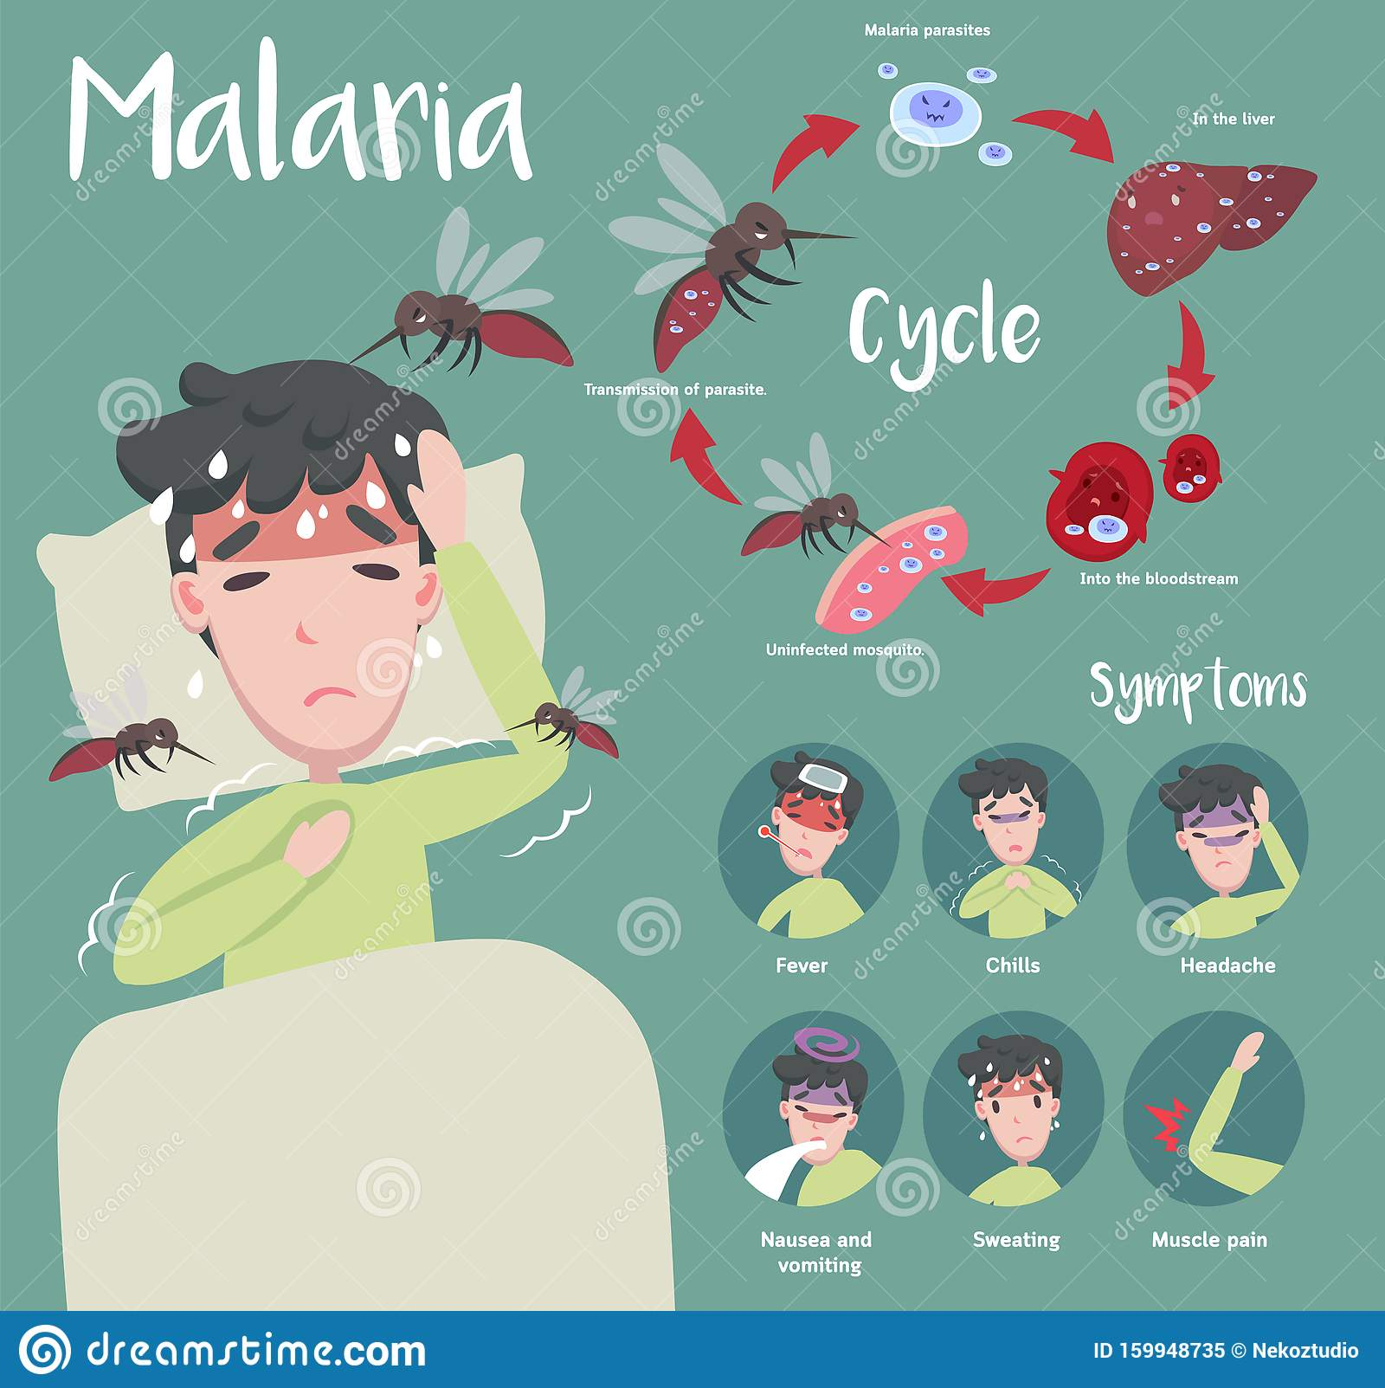
Malaria
High fever with chills in a few hours
Sweating

Slide 7
Typhoid
Cold with fever
Slow pulse
Diarrhea and dehydration
Trembling and delirium

Slide 8
Tuberculosis
Mild fever in the afternoon
Sweating at night

Slide 9
Childbirth fever
Fever
Foul-smelling vaginal discharge
Pain
Bleeding

Slide 10
Pneumonia
Fever
Fast, shallow breathing
Cough with green, yellow
or bloody mucus
Pain in chest

Slide 12
Question
1. What is shock?
2. What are causes of shock?
3. What are signs of shock?

Slide 13
1. Definition
Shock is a life- threatening condition that develops when the body’s blood pressure drops dangerously low.

Slide 14
2 Causes of shock?
Great pain
A large burn
Losing a lot of blood
Severe illnesses
Dehydration
Severe allergic reaction

Slide 15
2.3. Signs of shock
Weak, rapid pulse
Cold sweat
Pale, cold, damp skin
Mental confusion
Weakness
Loss of consciousness

Slide 16
Ex1: Circle the correct answer
PRACTICE
1. You should take the temperature of a sick person:
A. at night
B. four times a day
C. when he seems to have a fever
D. in the morning
2. We can use……………to take the patients' temperature.
A. thermometer B. bite C. kilometer D. kilogram
3. Take the temperature at…………..4 times each day and write it down.
A. last B. least C. lest D. less
4. ………………is an infection that fills your lungs with fluid.
A. Childbirth fever B. typhoid C. pneumonia D. tuberculosis
5. Shock is a …………… medical condition that occurs when body is not getting enough blood flow.
A. Dangerous B. threatening C. life- threatening D. immediate

Slide 17
Ex2: Fill in the blank
1. In new born babies, a temperature that is unusually high or unusually low (below 36 degree) may mean a……………………
2. People who have…………...... usually feel very sick with a high fever and chills
3. ……………….begins like a cold. Temperature goes up a little more each day. Pulse relatively slow.
4. There is a mild fever in the afternoon. At night the person often sweats, and the fever goes down. This disease is…………
5. People who have a high fever, bad smelling vaginal discharge, lower abdominal pain may have…………..
serious infection
malaria
typhoid
tuberculosis
childbirth fever

