Slide 1
stroke
Grammar: The past perfect tense

Slide 2
Stroke Stroke is a life-threatening condition that occur when the body is not getting enough blood flow. Lack of blood flow means the cells and organs do not get enough oxygen and nutrients to function properly. Many organs can be damaged as a result.

Slide 3
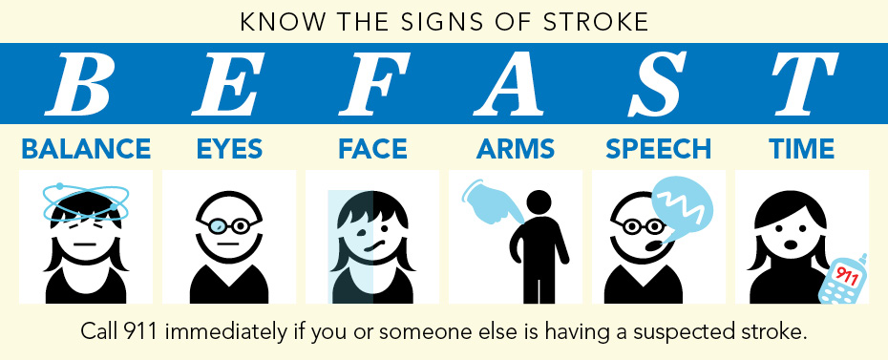
What are the symptoms of a stroke?
Sudden trouble walking, dizziness, loss of balance or coordination.
Sudden trouble seeing or blurred vision in one or both eyes.
Sudden numbness or weakness of the face, arm, or leg, especially on one side of the body.
Having trouble talking, or understanding what others are saying.

Slide 4
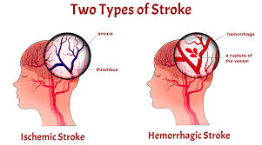
What are the causes of stroke?
Causes of stroke include ischemia(loss of blood supply) or hemorrhage (bleeding) in the brain.

Slide 5
Who is at risk for a stroke?
Have diabetes
smoke
Have high blood pressure
Have high cholesterol

Slide 6
Prevention
You can prevent stroke by:
quitting smoking
controlling blood pressure
maintaining a healthy weight
eating a healthy diet
exercising regularly
avoiding alcohol or drinking moderately

Slide 7
Reading comprehension
Julie’s grandmother was 56 years old when she had a stroke. It happened on Juile’s birthday. They had been at her grandmother’s house. Her grandmother was cutting the cake. All of a sudden she dropped the knife. She said her hand and arm felt numb. They took her to the hospital. Her grandmother had had a stroke. In the hospital the stroke became worse. The entire left side of her body became paralyzed. She stayed in the hospital for several weeks. At first she could not talk well. She slurred her words. After a couple of weeks her speech improved. When her grandmother, Doris, stayed in the hospital, a therapist taught her exercises so her left arm and leg could not get any worse.
When Doris came home from hospital she used a walker. For the past 7 years she has used a cane. Since she was left-handed, she has to learn how to do everything with her right hand. Often Julie pushes her grandmother in a wheelchair when they go shopping.
Doris has high blood pressure and high cholesterol. A couple of days before her stroke, she has been stirring soup when her hand became numb for a while. That was only warning sign she had. Some people do not have any warning symptoms. In most cases, the disability reaches its maximum within minutes, but occasionally, as in the case of Julie’s grandmother, it can take several hours. Doris’s stroke was caused by a blood clot in her carotid artery. The carotid artery is in the neck and leads to the brain.
Julie’s dad recently stopped smoking since smoking can add to the risk of a stroke.
He has started an exercise program to help bring down his high blood pressure. Now he is learning about eating low fat diet. This will also help reduce the risk of a stroke.

Slide 8
Grammar and vocabulary practice
Complete the following sentences with the Past Perfect Tense
1. We (give) him first aid by the time ambulance arrived.
2. The doctor wanted to know what the nurse (do).
3. Mary didn’t get home until after her parents (go) to bed.
4. I found my way to clinic after I (ask) the theater sister the way.
5. You lost your new gloves soon after you (buy) them, didn’t you?
6. When John (recover) from his operation, he was sent home.
7. The doctor did not arrive until the patients (finish) their breakfast.
8. As soon as the surgeon (examine) the X-ray, he started the operation.

Slide 9
Choose the best answer
The nurse who admitted Long asked what………to him.
A) happens
B) happened
C) did happened
D) had happened
After the surgeon…………… the patient, he……….. him there was nothing to worry about.
A) had examined/ told
B) examined/ told
C) had examined/ had told
D) examined/had told
Yesterday she……up full of pains. She …wet the previous day on the way home from work.
A) woke up/got
B) woke up/had got
C) had woken up/got
is waking up/got
He…………..no improvement although he……….. his doctor’s advice.
A) saw/followed
B) didn’t see/ had followed
C) had seen/followed
saw/ had followed
The nurse took John’s pulse and blood pressure after she ………………him to hospital
A) has admitted
B) was admitted
C) had admitted
D) admitted

