Slide 1
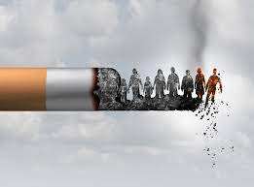
Smoking

Slide 2
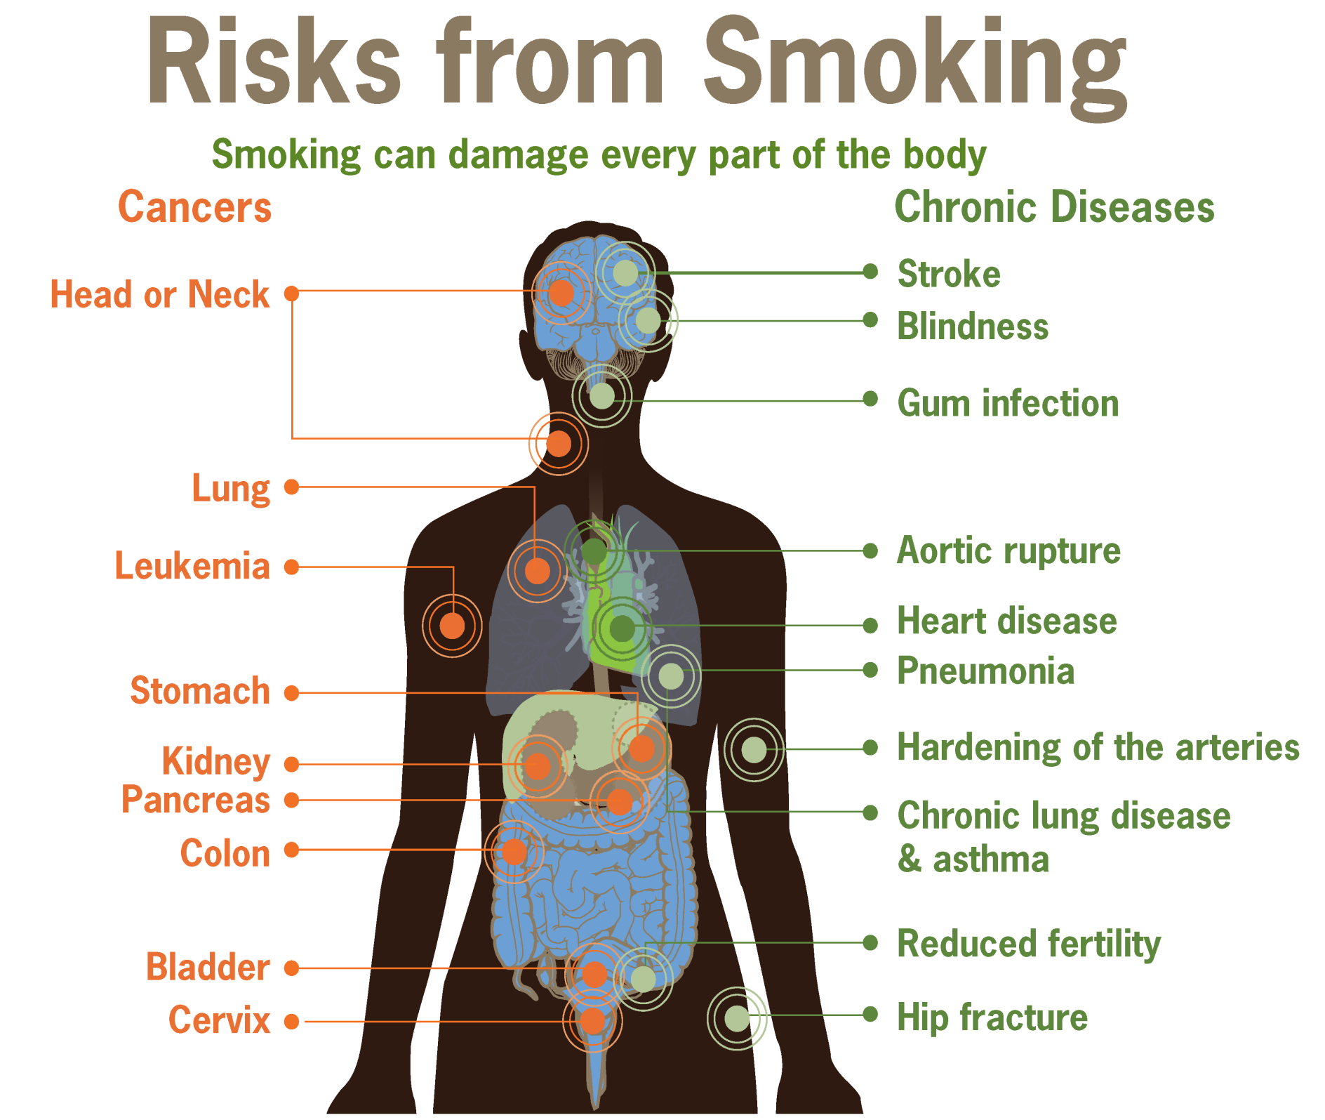

Slide 3
Consequences of smoking
Brain
Bones
Skin
Lung cancer
Mouth/teeth
Heart disease
Immune system
Reproduction

Slide 4
Brain
Smoking can increase the likelihood of having a stroke which can cause brain damage and death.
Smoking- stroke- brain- death

Slide 5
Bones
Smoking:
makes the bones weaker and more brittle.
reduces bone healing after a fracture.

Slide 6
Skin
Smoking reduces the amount of oxygen reaching the skin.
make skin gray and dry

Slide 7
Lung cancer
Smoking increases the risk of many types of cancer such as mouth, throat, liver, stomach especially lung cancer

Slide 8
Mouth, teeth
bad breath
dry mouth
stained teeth

Slide 9
Heart
Smoking:
damages the blood vessels makes blood vessels narrower hard for blood to flow
increases the risk of blood pressure and heart disease

Slide 10
Immune system
The immune system protects the body against infection and other diseases.
Smoking reduces immune function in the body.

Slide 11
Reproduction
Females who smoke can have more difficulty in becoming pregnant.
Males who smoke can damage blood vessels in the penis.

Slide 12
Expressing purposes
to +V
in order to +V
so as to + V
so that + clause ( s + can/could +v…..)
Eg: He learns hard to/in order to/so as to pass the exam
= He learns hard so that he can pass the exam

Slide 13
Ex1-p43: Complete the following sentences with “so that” or a suitable infinitive with “to”
so that
1. A day room is provided........................ ambulant patients have somewhere to relax.
2. The patient was given an antibiotic........................the onset of infection.
3. The doorways are always wide enough........................patients in wheelchairs enter with ease.
4. Some side wards have their own basins and lavatories........................ suitable accommodation is provided for infectious patients.
5. The beds are arranged........................patients can be observed without difficulty.
6. Hospital planners have used bright colors........................a cheerful atmosphere.
7. The patient was given an injection of morphine........................shock and pain.
8. Jane studied hard........................she could pass her examinations.
9.Furniture and fitting are designed........................ They can be cleaned easily
10.Mary made notes at the lecture........................she could remember the important points.
to prevent
to help
so that
so that
to create
to prevent
so that
so that
so that

Slide 14
Ex3-p44 Us e each word once to fill in the blanks
smoking senior lung pain relationship college gum cough blood cigarettes quit breath chest matches complaints
1.It is dangerous to play with.......................................................................
2. She smokes ten............................................................................a day.
3. She wants to....................................................smoking.
4. He will be a..............................................................in college.
5. His grandmother died of........................................................cancer.
6. My sister has a...............................................................in her chest.
7. She chews.............................................instead of smoking cigarettes.
8. After walking up the stairs, she was out of.......................................
9. The doctor hears many....................................................everyday.
10. He has a very deep..................................................................................
11. He has been............................................since he was sixteen years old.
12. They plan to attend a..............................................near their home.
13. Jeff plans to donate.....................................................
14. When he is worried about his......................with his girlfriend, he smokes.
15. When she coughs her........................................................................hurts.
matches
cigarettes
quit
senior
lung
pain
gum
breath
complaints
cough
smoking
college
blood
relationship
chest

