Slide 1
UNIT 9: POSSIBILITIES
GRAMMAR: Would; second conditional

Slide 2
MỤC TIÊU BÀI HỌC
Sau khi học xong bài học sinh viên có khả năng: Kiến thức: 1. Thuộc cách sử dụng của động từ Would 2. Viết được câu khẳng định, phủ định và nghi vấn với động từ Would 3. Sử dụng Would trong câu điều kiện loại 2
Kỹ năng: 4. Đọc hiểu bài: Smart shopping
5. Nhận biết được cách dùng của Would trong câu điều kiện loại 2.
Năng lực tự chủ và chịu trách nhiệm: 6. Chủ động phát biểu tham gia xây dựng bài.

Slide 4
Form :
(+) S + would ( ’d ) + V
I would like to live alone.
(-) S + would not + V
( wouldn’t )
I wouldn’t steal from a friend.
(?) Would + S + V ?
Short answers: Yes, S + would
No, S + wouldn’t
Would you like to live alone ?
Yes, I would .

Slide 5
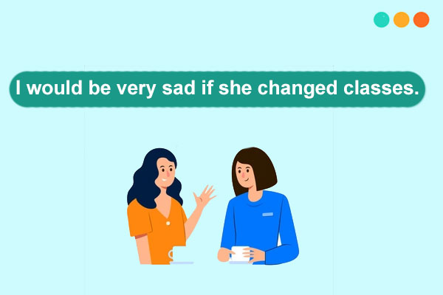
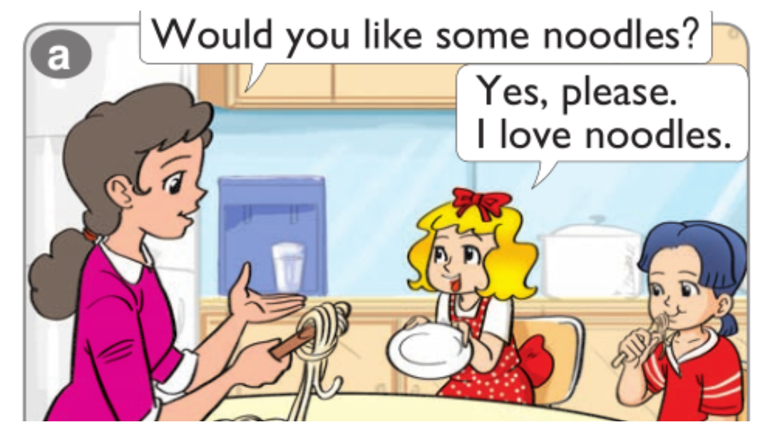
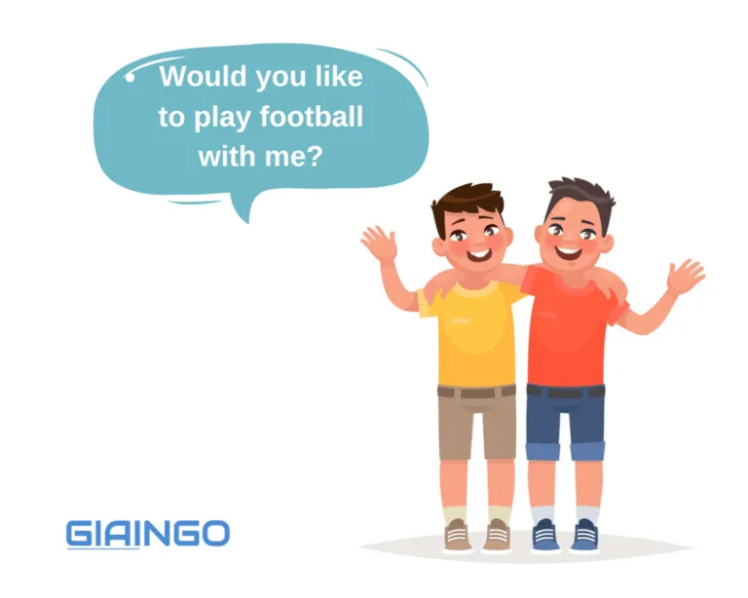
Use
1. Diễn đạt một tình huống không thể xảy ra ở hiện tại.
2. Để chỉ thói quen trong quá khứ.
3. Dùng trong câu đề nghị một cách lịch sự.
Would you mind + V-ing ….? ( Bạn có phiền …? )
Would you like +N/to +V ? ( Bạn có muốn…?

Slide 6
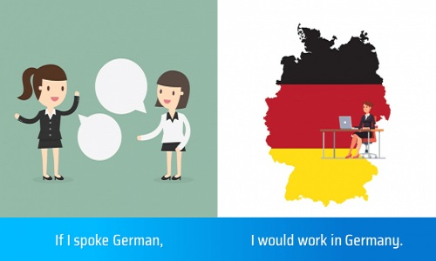
Second conditionals (Câu điều kiện loại 2)
Cách dùng
1. Dùng để diễn tả một hành động, sự việc có thể sẽ không xảy ra trong tương lai.
2. Dùng để khuyên bảo, đề nghị hoặc yêu cầu.
Công thức
Mệnh đề điều kiện | Mệnh đề chính
If + S + V-ed/V2 | S + would/could/should... + V-inf
*Lưu ý: Người bản xứ thường sử dụng dùng "were" ở tất cả các ngôi thay cho "was".

Slide 7
1. Look at the speech bubbles. Are the people talking about real or an imaginary situation?
What would your ideal day be like? What would you do?
What wouldn’t you do?
What would your ideal day be like? What would you do?
What wouldn’t you do?
I’d spend the day on the beach
I wouldn’t get up till midday
I’d spend the day on the beach
I would tell my boss that he’s a boring old fool
I would tell my boss that he’s a boring old fool
2. Do you agree with any of the ideas?

Slide 8
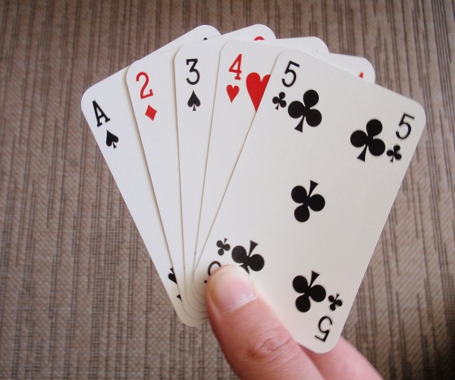
Practice 1: Make sentences
1.When/my grandma/come/visit/we/play cards/every day.
2.When/Jane/be /university/she/study/3 hours/every evening.
3. He/be/ here/but/he /have too much work/ at the moment
4.Would /you/like/go/cinema?

Slide 9
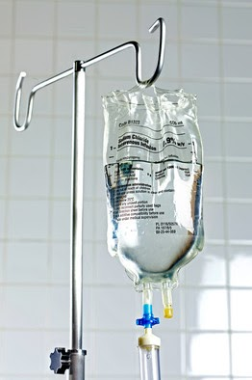
Practice 2: Write the answers
1. What would you do if you were a nurse?
2. What would you do if you were a pharmacist?

Slide 10
Practice 1: Answer the questions
1 A: What would you do if you found some money?
B: I’d ……..
2 A: What would you do if someone tried to sell you a video recorder cheaply?
B: I’d ………..
3 A: What would you do if you saw your friend trying to steal something from a shop?
B: I’d …………
4 A: What would you do if you couldn’t afford you car insurance?
B: I’d ………..
5 A: What would you do if a shop assistant gave you too much change?
B: I’d ……….

Slide 11
Practice 2: Write about yourself
If I found some money, I’d ……………
If somebody tried to sell me a video recorder cheaply, I’d……..
If I saw my friend trying to steal something from a shop, I’d…..
If I couldn’t afford my car insurance, I’d…….
If a shop assistant gave me too much change, I’d………

Slide 12
Practice 3: Match a clause in A and a clause in B.
A B
If I found a credit card , I’ll be very happy
I’ll play the guitar If I see him
If it’s sunny tomorrow, I wouldn’t use it
I’ll tell him your news If you sing
I’d go round the world She’d be very happy
If Sarah got the job, If I was rich

Slide 13
Practice 4: Complete the sentences with your own ideas
If I found 1 thousand pound, I’d ……….
……….. ……… I’d be very sad.
If it rains this week, ……………………….
If you study hard, ……………………………..
…………………………. If you don’t hurry.
…………………………. If I was Prime Minister.

Slide 14
Vocabulary: Crime
1.Look at this list of crimes.
a. Use a dictionary to help you.
Which are crimes against people ?
Which are crimes against property ?

Slide 15
b. Find the words for these columns.
crime criminal action
murder murderer to murder
assault attacker/mugger to attack / to mug
robbery robber to rob / steal
theft thief to rob / steal
shoplifting shoplifter to shoplift / steal
blackmail blackmailer to blackmail
kidnapping kidnapper to kidnap
burglary burglar to burgle
vandalism vandal to vandalize

Slide 16
C. Which crimes would you associate these words with ?
word
shoot
break into
threaten
money
knife
hit
gun
grab
smash
stab
crimes
murder,assault
robbery,theft,burglary,vandalism
blackmail,kidnapping
robbery,theft, blackmail,kidnapping,burglary
murder,assault
assault
murder,assault,robbery
robbery,theft,shoplifting,kidnapping
vandalism, burglary
murder,assault

Slide 17
Reading : Would you get involved ?
1.Read the text and answer the questions.
a. What happened to each of these people ?
Dave Johnson
Pauline Castle
James Bulger
Kitty Genovese
Dave Greenwood
b. What do the police advise ?

Slide 18
2.Read the text again.
a. Find three reasons why people do not get involved.
b. Which case illustrates each of the reasons ?

Slide 19
4.Here is an incident that happened to Peter Morris.
Describe what happened, using the information.

Slide 20
Listening and speaking : Checking into a hotel
1.Look at the photograph. A guest is checking into a hotel. Imagine the conversation with the receptionist.
a. What words and expressions would you hear ?
words / expressions reservation
single room
suitcase
credit card
b. What would they say to each other ?
Have you got a reservation ?
Would you like a single or a double ?
Do you need any help with your suitcase ?

Slide 21
2. Look at the conversation.
a. Complete the conversation with these words.
Re: Good evening, sir.
Gu: Good evening. Do you have a……………....in the………
of Jones, please ?
Re: Just a…………,sir. Yes, here we are. Mr Alan Jones.
Would you like a……….room or a double Mr Jones ?
Gu: I’d prefer a double, If you’ve got one.
Re: And how many…………are you staying ?
Gu: Three.
Re: Fine.Well, could you just fill in the………………form and
…………it at the bottom, please ?
Gu: yes, certainly.
Re: And how do you want to settle the…….?
Gu: By……………,if that’s all right.

Slide 22
Re: Yes, of course. Could I just take an…………of the card,sir ?
Gu:Yes, here you are.
Re: Thank you. And will you require a newspaper and a………......
…….in the morning ?
Gu: Yes, I’d like The Times and a call at 7.30, please.
Re: 7.30. Very good, sir. Here’s your……….Your room…………
is 429.The……….is over there. Do you need any help with your ………….?
Gu: No, thank you. I’ve only got a small……………
Re: Well, enjoy your stay.
Gu: Thank you.

Slide 23
Conversation pieces : Polite requests
b. Find the expressions in the conversation. How do the people respond to the requests ?
Could you just fill in the form and sign it at the bottom, please?
Yes, certainly.
Could I just take an imprint of the card, sir ?
Yes, here you are.

Slide 24
c. Take it in turns to make the following requests and respond.
* Ask someone to
sign the form at the bottom.
Could you (just) sign the form at the bottom, please ?
excuse you, while you make a telephone call.
Could you (just) excuse me while I make a telephone call, please ?
get your suitcases from your car.
Could you (just) get my suitcases from the car, please ?
see if there are any messages for you.
Could you (just) see if there are any messages for me, please ?
put your bag in the room.
Could you (just) put my bag in my room, please ?
send a fax for you.
Could you (just) send a fax for me, please ?

Slide 25
* Ask if you can :
borrow a pen.
Could I (just) borrow a pen, please ?
see someone’s passport.
Could I (just) see your passport, please ?
check the bill.
Could I (just) check the bill, please ?
make a phone call.
Could I (just) make a phone call,please ?
leave your bags there.
Could I (just) leave my bags here, please ?
cancel your wake-up call.
Could I (just) cancel my wake-up call,please ?
d.Look at your requests.Who would make them,guest (G)or receptionist (R) ?

Slide 26
Pronunciation : - ou- ; emphatic stress
1.The vowels -ou-.
The vowels -ou- can be pronounced in many diffirent ways.
a.Look at this list of words. Put them into the correct column.
/ɔ:/
/ʊ/
/ u: /
/ ʌ /
/au/

Slide 27
2.Emphatic stress
When we want to emphasize certain information in a sentence, we stress that part.
a. The stress can go on three different parts.
1 2 3
We need to be at the meeting at three o’clock.
The different stresses change the meaning.

