Slide 1
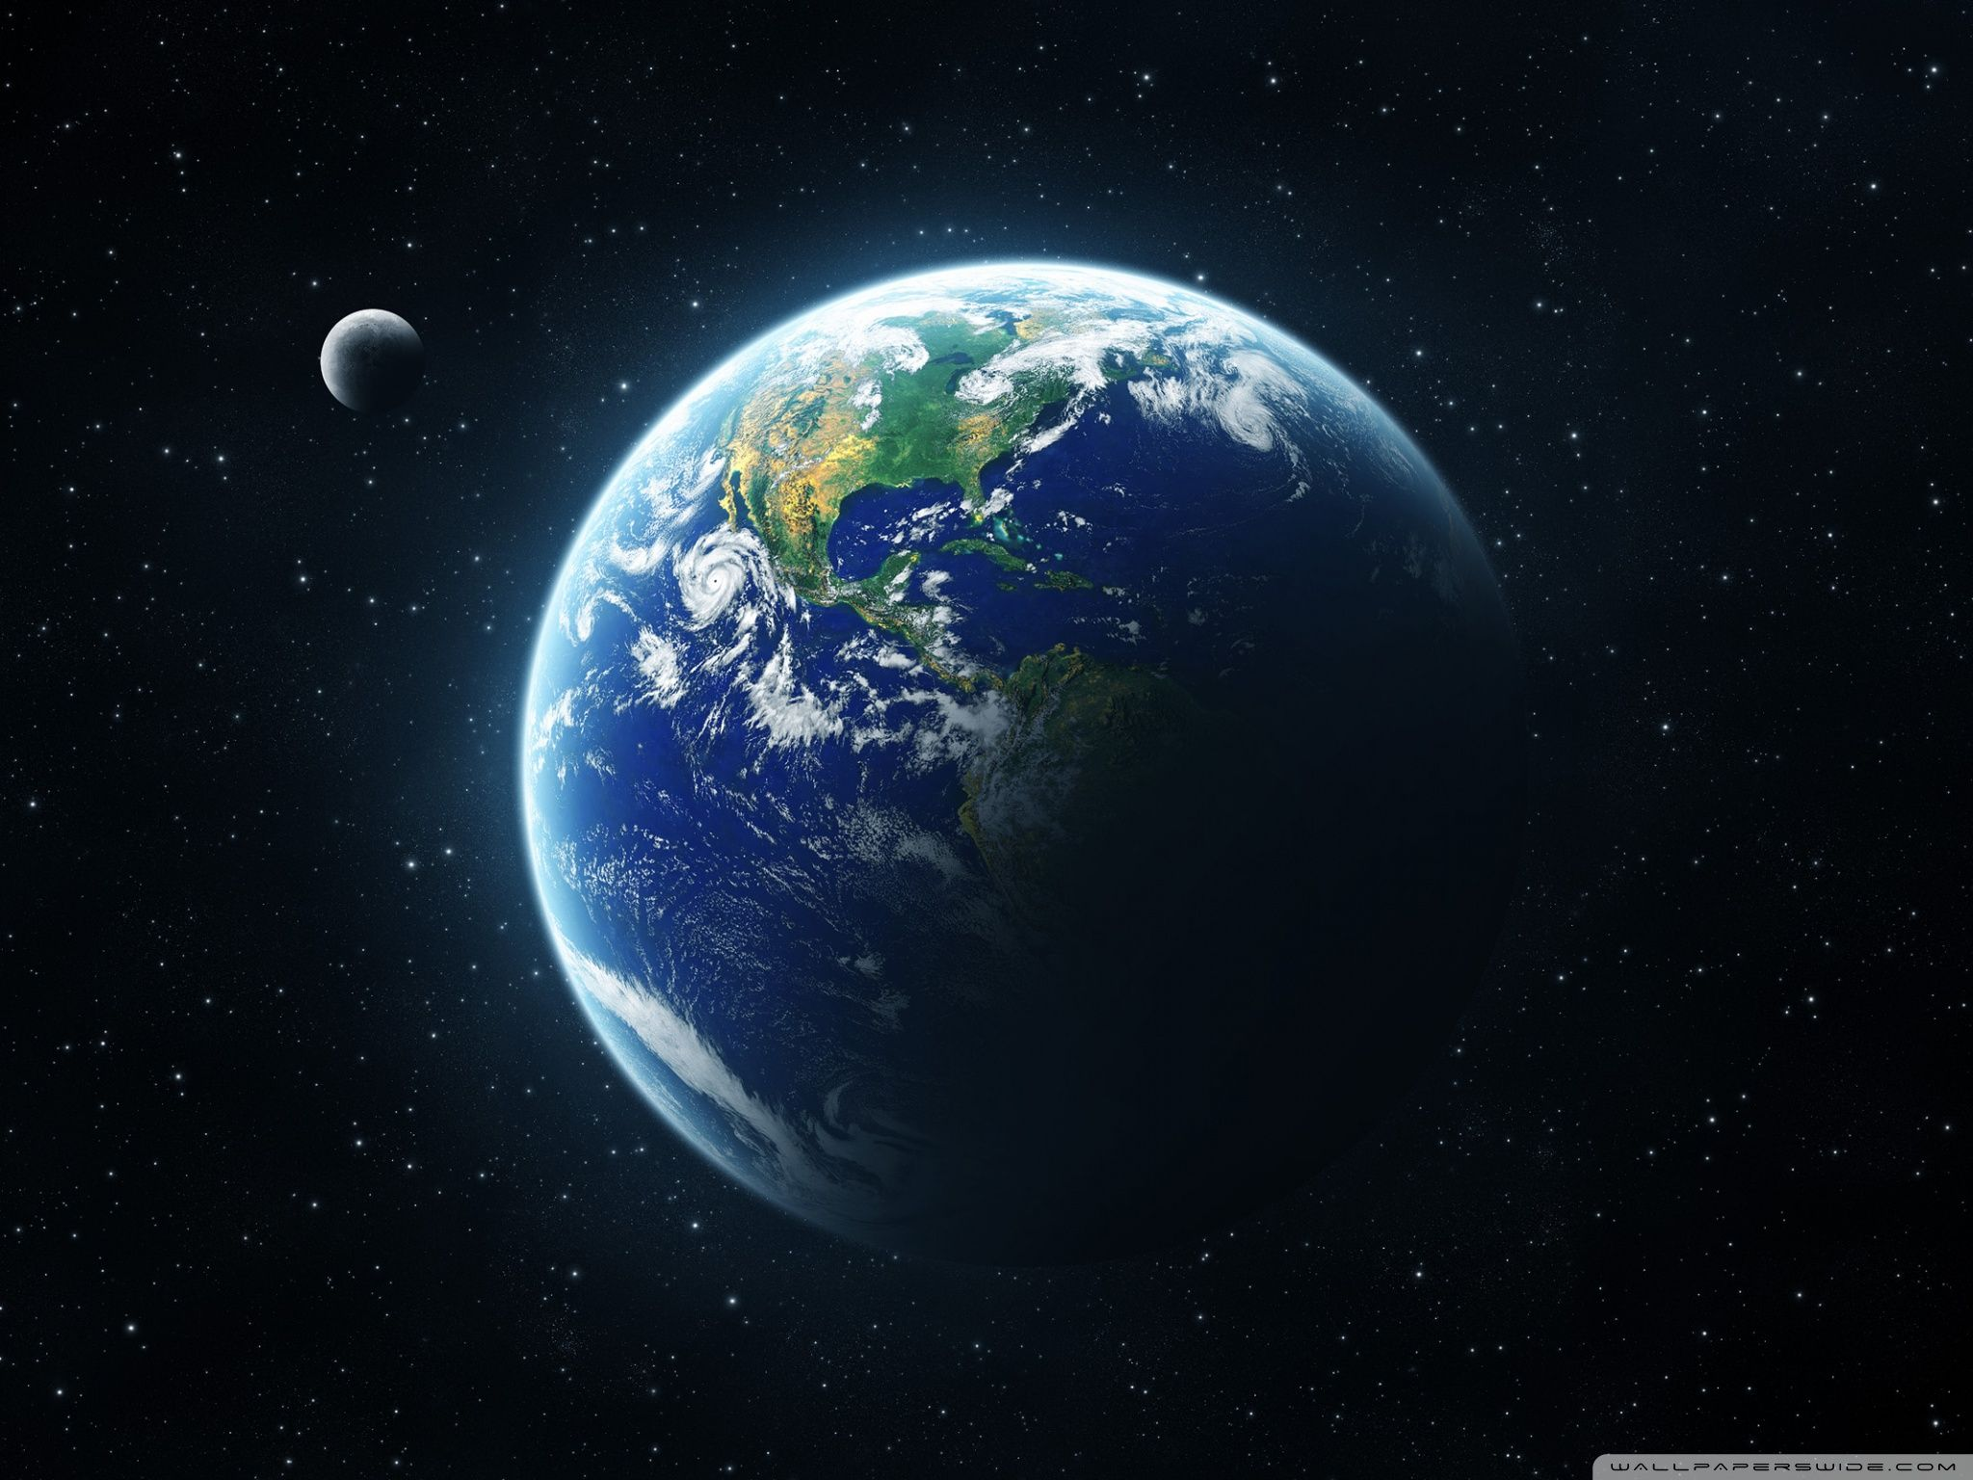
Unit 12: Planet Earth

Slide 2
OBJECTIVES
By the end of the lesson, students will be able to
*Knowledge:
1.Use the forms of passive voice in all tenses.
2.Distinguish disposable equipment and non- disposable equipment.
3.Present how to set the trolley for sterile procedure.
*Skills:
4.Transform active form into passive form and vice versa
*Learner autonomy and responsibility:
5.Have positive attitude to learn, use English in daily communication.

Slide 3
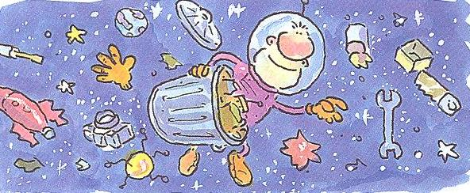
Look at the cartoon.
What do you think the text will be about ?
b. Can you identify any of these things on these pages ?
rubbish debris space satellite
spacecraft orbit rocket
c. Read the text and check your ideas.

Slide 4
2. Answer these questions.
1.What is it about ?
2. How has the situation been created ?
3.Why is the situation dangerous ?
4.What will happen in the future ?

Slide 5
* Rules
1.The text shows many verbs in the passive.
a. Complete these sentences from the text.
1.On 4 October 1957 the first satellite, Sputnik_______
2. Since then, thousands of spacecraft__________ into space.
3. Every few weeks new satellites ________ into orbit.
4. Unfortunately, space_______________ by debris from these space flights.
5. An astronaut ____________ if he or she was hit by a piece of rubbish.
6. Sooner or later a satellite ______________ by a large piece of rubbish.

Slide 6
present simple:
- present continuous :
- past simple :
- past continuous:
- present perfect :
- past perfect :
- future:
S + am/is/ are + Vp2
S + am /is / are + being + Vp2
S + was/ were + Vp2
S + was/ were + being +Vp2
S + have/ has + been + Vp2
S + had been + Vp2
S + will + be + Vp2
Form

Slide 7
b. The verbs in the sentences are all in the passive.
1. What two parts does a passive verb have?
The verb to be and the past participle.
2. What tense is each sentence in ?
Past simple, present perfect, present simple, present continuous, future with will, would.
3.Which part of the passive verb changes to show the tense?
The verb to be
c. Complete the rule.
We form the passive with the correct tense of the verb ______+ the past participle.
to be

Slide 8

d. Find more examples of the passive in the text.
Which tense are they in?
Eg: - More than 70,000 objects have been left in space.
- Part of rockets have been left. Old satellites have
been abandoned.
- Other items have been lost by astronauts.
- Both Russian and American spacecraft have been
damaged.
(present perfect)
- …….if nothing is done…….
(present simple)
- …thousands more pieces will be scattered.
(future with will)

Slide 9
2. When do we use the passive?
Look at these two sentences.
- Russia launched the first satellite in 1957. (active)
- The first satellite was launched by Russia in 1957. (passive)
* Do they mean the same?
They mean the same.
b. Answer these questions.
If we remove Russia from the active sentence, we get
Launched the first satellite in 1957.
* Does it still make sense ?
No, there is no subject.
2. If we remove by Russia from the passive sentence, we get
The first satellite was launched in 1957.
* Does it still make sense?
Yes
c. Complete the rules with more or less.
We use the passive when the action is _____ important
than who or what does the action (the agent).
more

Slide 10
* Form
S + to be + past participle.
Eg: These cars are made in France.
English is spoken in many different countries.
* Note: We can use the passive in any tense. To make different tenses, we change the verb to be.
- Positive:
Eg; My bag was stolen. (past)
Three people have been injured. (present perfect)
The information is sent to main office. (present)
The weather will be affected by the volcano. (future)

Slide 11
- Negative: To make negative of the passive we use the negative of the verb to be.
Eg: My bag wasn’t stolen.
The people haven’t been rescued yet.
Gold isn’t moved from bank to bank.
The base won’t be reopened.
- Questions: To make questions we use the normal questions form of the verb to be in each tense.
Eg: Was your bag stolen ?
Have the people been rescued yet ?
Is gold moved from bank to bank ?
Will the base be reopened ?

Slide 12
* Use
The passive is very common in English. We use it when
we are more interested in the action than in who or what did it.
Carob seeds were used.
The evidence is examined.
If we want to show who or what does the action, we use by .
Carob seeds were used by the trader.
The evidence is examined by forensic scientists.

Slide 13
Practice
1. Put the verbs in brackets into the present simple passive.
The satellite ____________ (build).
It ____________ (test).
The satellite ____________(take) to the rocket launched site.
The rocket ____________ (prepare).
The rocket and satellite ____________ (launch).
The lower parts of the rocket ____________ (dump).
The satellite ____________ (put) into orbit.
The satellite’s own rockets ____________ (fire)
The satellite ____________ (move) into the correct orbit.
The rest of the rocket ____________ (leave) in space.

Slide 14
2.Look at this text about Skylab.
Complete the text with these verbs
in the past simple passive.
destroy sell hurt scatter send
abandon hit find launch
In 1973 a 75- tonne space station called
Skylab ___________ by the USA.
Three crews of three astronauts _________to the Skylab, but at the end of 1974 it ____________. Skylab stayed in space until 1979. Then it fell out of its orbit and headed towards the Earth. A lot of space station burnt up when it entered the atmosphere. But not all of it ____________. Large pieces ______________across the Indian Ocean. Australia ________ by some fragments. Fortunately nobody _______. A lot of the pieces ___________ by the Australian farmers. The pieces _______ for very high prices.

Slide 15
Examples:
Active: My sister cleans our house
S1
V1
O1
Passive: Our house is cleaned by my sister
S2 (=O1)
V2
O2 (=S1)
=> S + be +Vp2

Slide 16
3. Change these sentences from the active into the passive,
keeping the same tense.
1. A camera ……….by the American astronaut, Micheal Collins.
2. Eventually an astronaut ……….by a piece of debris.
3. The astronaut ……………by a normal spacesuit.
4. Communications satellites ……………by rubbish.
5. More rubbish …………….by today’s satellites.
6. One of the space shuttle’s windows …………..by a piece of debris.
7. Some satellites …………..back to Earth by the space shuttle.
8. 186 marks ……………by scientists on one satellite.
9. 166 of the marks ……………..by space debris.

Slide 17

Vocabulary: The natural world
1.Do you normally associate these words with space or with the Earth.
a. Write S or E next to each one.
space (S)
the Earth (E)

Slide 18
b. Look at the picture. Label as many of the things as possible, using the word in the box.
planet, moon, lake, atmosphere, sea, desert, peninsula, star, mountain, river, hemisphere, North Pole, continent, island, coast, ocean, equator, comet.

Slide 19

Reading: Comet !
Read the first two paragraphs and the last paragraph of the text. Each paragraph describes a similar event.
a. Answer the questions
What are the three events?
When do, or did, they happen?
Event 1:
Event 2:
Event 3:

Slide 20
Read the whole text quickly and answer the questions.
Which of the places on the map are mentioned?
2. How many fragments of the comet hit the Earth?
3. Where do they land? Map the places on the map.

Slide 21
3. Read the paragraph 3-5 more carefully.
a. Math the items in column A and column B.
A | B
First fragment Second fragment Effect | shock waves clouds of dust and water vapour tidal wave

Slide 22
b. Look at the events in column B.
What causes each one?
What effects does each have?
Cause
Effect
The shock waves are caused by the second fragment landing in Argentina.
Earthquakes and volcanoes are
set off by the shock waves.
The clouds of dust and water vapour are caused by the debris thrown into the atmosphere by
the explosions and the volcanoes.
The sun is hidden by the clouds
and the temperature falls to
almost zero.
The tidal wave is caused by a
large fragment hitting the South Atlantic.
Coastal cities in Africa and Asia
are destroyed by the tidal wave.

Slide 23

c. Use the information above and write sentences to summarize paragraph 3-5.

Slide 24
Listening and speaking
Oh, really ?
1. Match the sentences and photographs. How would you respond to the news.
1. Peter and I are getting married.
2. I’ve got an interview for a job today.
3. John can’t play today. It seems he’s had an accident.
4. Did you know Tony and Rosie have split up?
5. I won the gold medal in the race.
6.I’m expecting a baby.
7. I’m afraid I failed my driving test.
8. Have you heard ? Sue had her baby on Saturday.
9. Happy Birth day, Mummy !

Slide 25
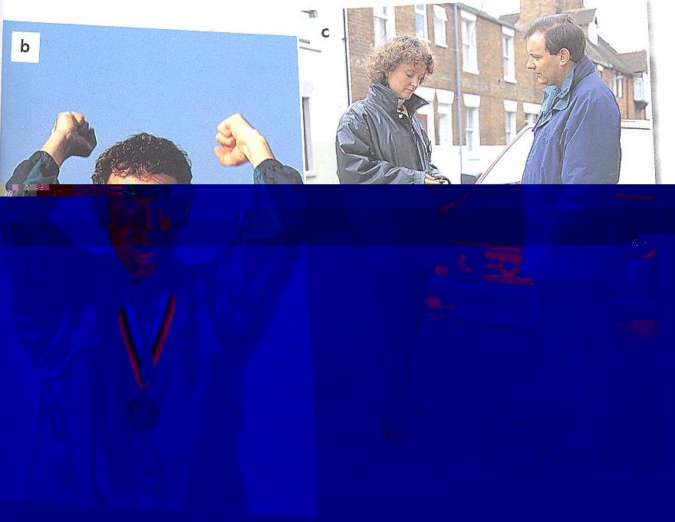
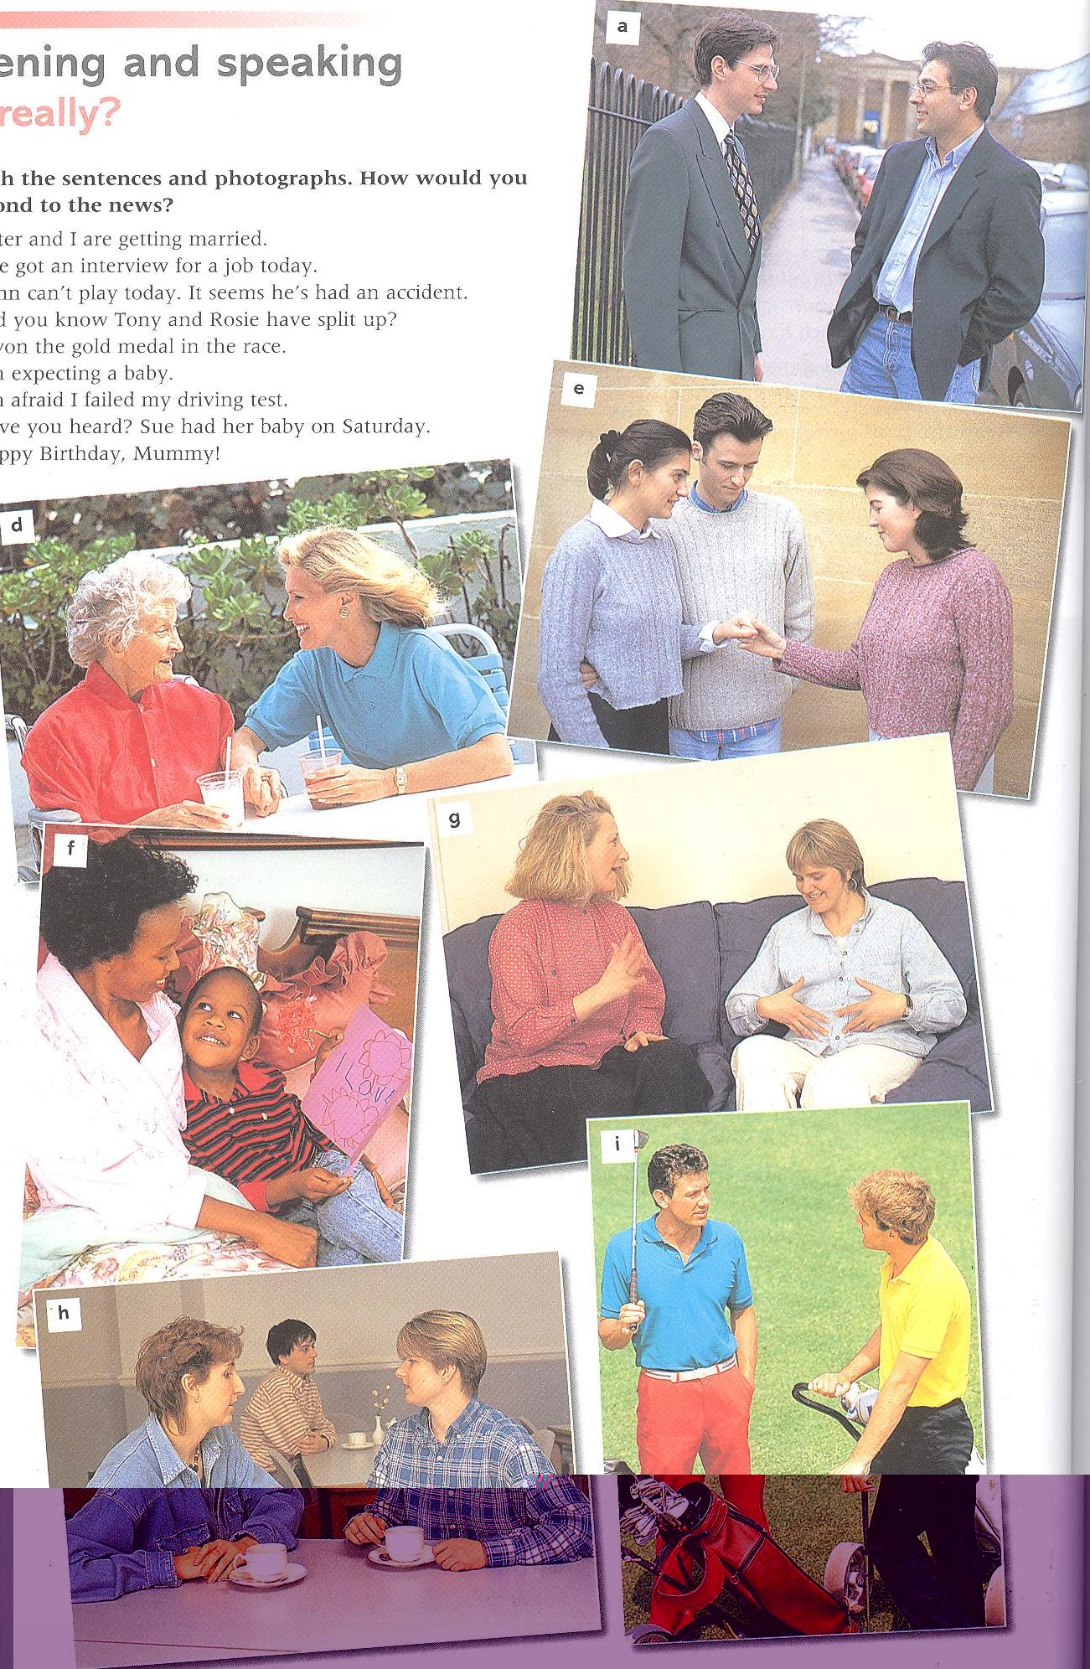
Match the sentences and photographs.

Slide 26
2. Look at these responses.
a. Choose the most appropriate response for each of the sentences in 1.
1. Peter and I are getting married.
2. I’ve got an interview for a job today.
3. John can’t play today. It seems he’s had an accident.
4. Did you know Tony and Rosie have split up ?

Slide 27
5. I won the gold medal in the race.
6. I’m expecting a baby.
7. I’m afraid I failed my driving test
8. Have you heard? Sue had her baby on Saturday.
9. Happy birth day, Mummy!
b. Listen and check.

Slide 28
c. Some of the responses are not appropriate for the
sentences in 1. When would you use them?
A: Marry Christmas !
B: And a Merry Christmas to you, too.
A: How did you like your present?
B: It’s just what I’ve always wanted.
A: Cheers !
B: Cheers! All the best !
A: Thank you very much for your help.
B: That’s all right. Don’t mention it.
A: We’ve been married for ten years today.
B: Happy Anniversary !

Slide 29
3. Listen again and pay attention to the intonation.
Practise saying the respones.
b. Work with a partner and roleplay the conversations.
c. Choose two of the conversations and continue them.
4. Make more conversations.
Look at these situations.
You’ve just passed your driving test.
A member of your family is in hospital.
You’ve just won a free holiday in a competition.
You’ve lost your job.
A friend of yours is getting married.

Slide 30
Pronunciation
/ə/ ; word linking (1)
1. The /ə/ sound.
a. Look at the list of words. Circle the syllables with the /ə/ sound. Not all the words contain the sound.
satellite probably
volcano explosion
camera dinosaur
rubbish disappear
unfortunately survive
spanner collapse
atmosphere million
accident extinct
yesterday evacuate
astronomer suddenly

Slide 31
2. Word linking (1)
a.Mark the word linking in these sentences.
1. He’s had an accident.
2. My birthday’s in August.
3. It landed in the South Atlantic.
4. Their plane arrives at eleven.
5. John and Ellen have split up.
6. It’s what I’ve always wanted.
7. I’m expecting a baby.
8. I get up at eight o’ clock.

