Slide 1
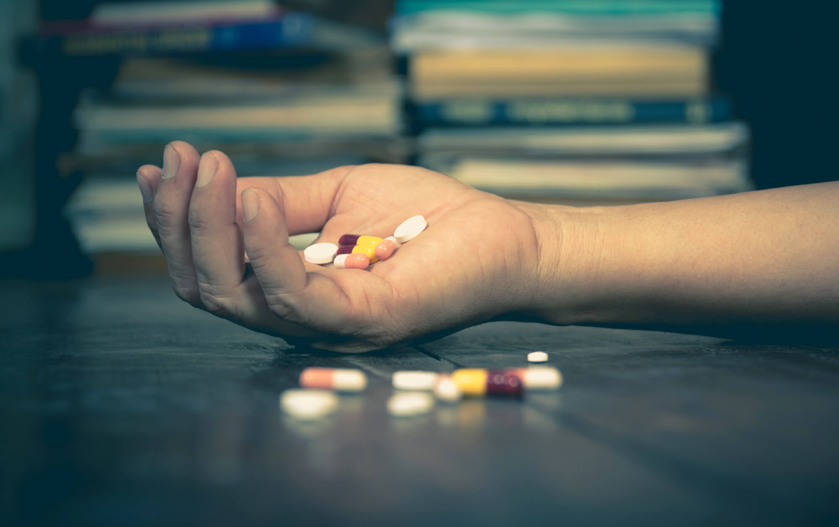
Drug abuse

Slide 2
Vocabulary
- Medicine/drug (n) / ‘medisn/
- Prescription /prɪˈskrɪpʃn/ (n) :an official piece of paper on which a doctor writes the type of medicine you should have, and which enables you to get it from a phamacy
eg:The doctor gave me a prescription for antibiotics yesterday
-Instruction /ɪnˈstrʌkʃn/ (n) :detailed information on how to use something
eg: Follow the instructions on the packet carefully.

Slide 3
- Dose /dəʊs/ (n) :an amount of a medicine that is taken once
- Low dose> high dose>overdose
Effect /ɪˈfekt/
Side effect/ unexpected effect
Precaution/ prɪˈkɔːʃn/ :something that is done in advance in order to prevent problems or to avoid danger

Slide 4
- Pharmacy /ˈfɑːməsi/ a shop that sells medicines
- Pharmacist (n) /ˈfɑːməsist/
- Pharmaceutical (adj) /ˌfɑːməˈsjuːtɪkl/
- The pharmaceutical industry
- The pharmaceutical product
- The pharmaceutical company

Slide 5
- Label (v,n)
- Be allergic to sth
- Be addicted to sth
- Abuse (v,n)
-Take medicine
-Help sb take medicine
-Give/deliver sb medicine
- Administer medicine

Slide 6
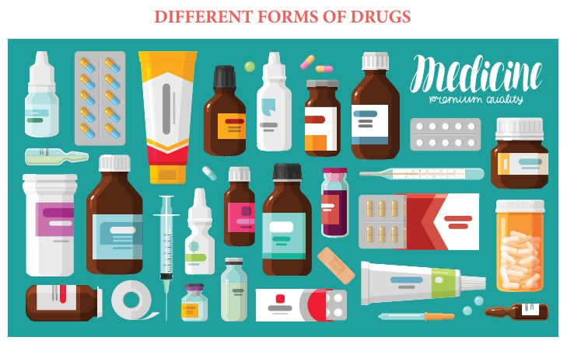

Slide 7
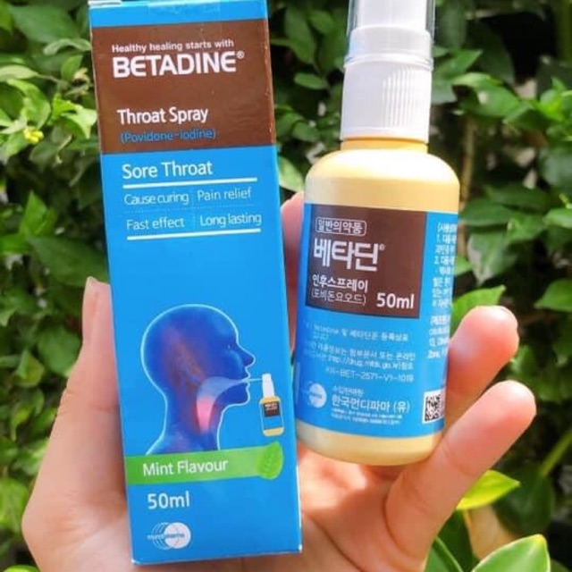
Aerosol
/ˈeərəsɒl/

Slide 8
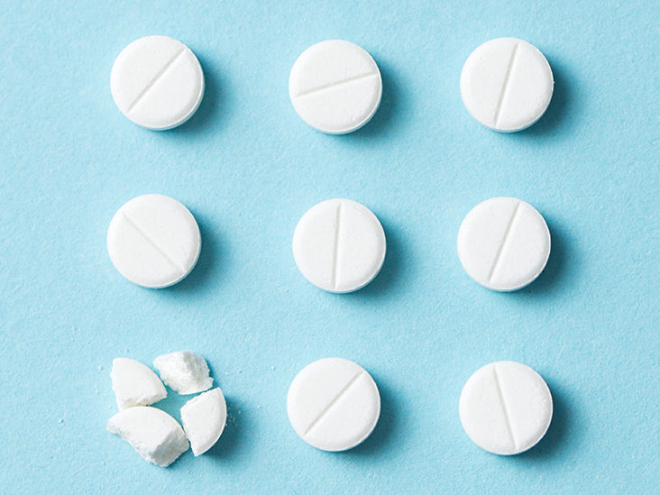
tablet /ˈtæblət/

Slide 9
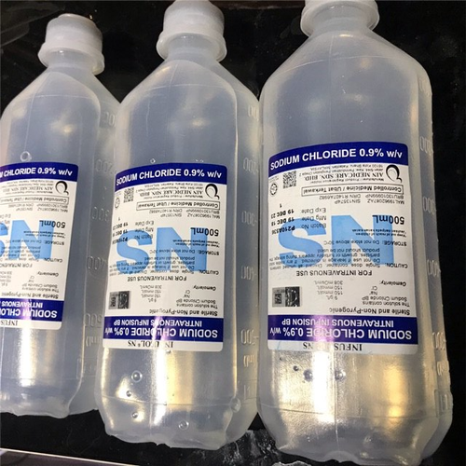
Solution
/səˈluːʃn/

Slide 10
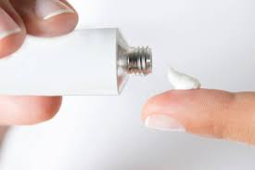
Ointment
/ˈɔɪntmənt/

Slide 11
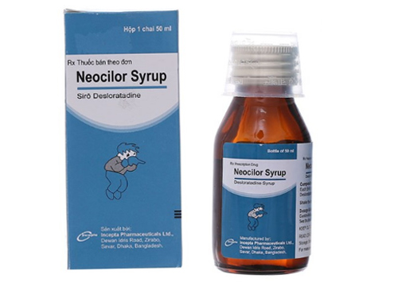
Syrup
/ˈsɪrəp/

Slide 12

drop

Slide 13
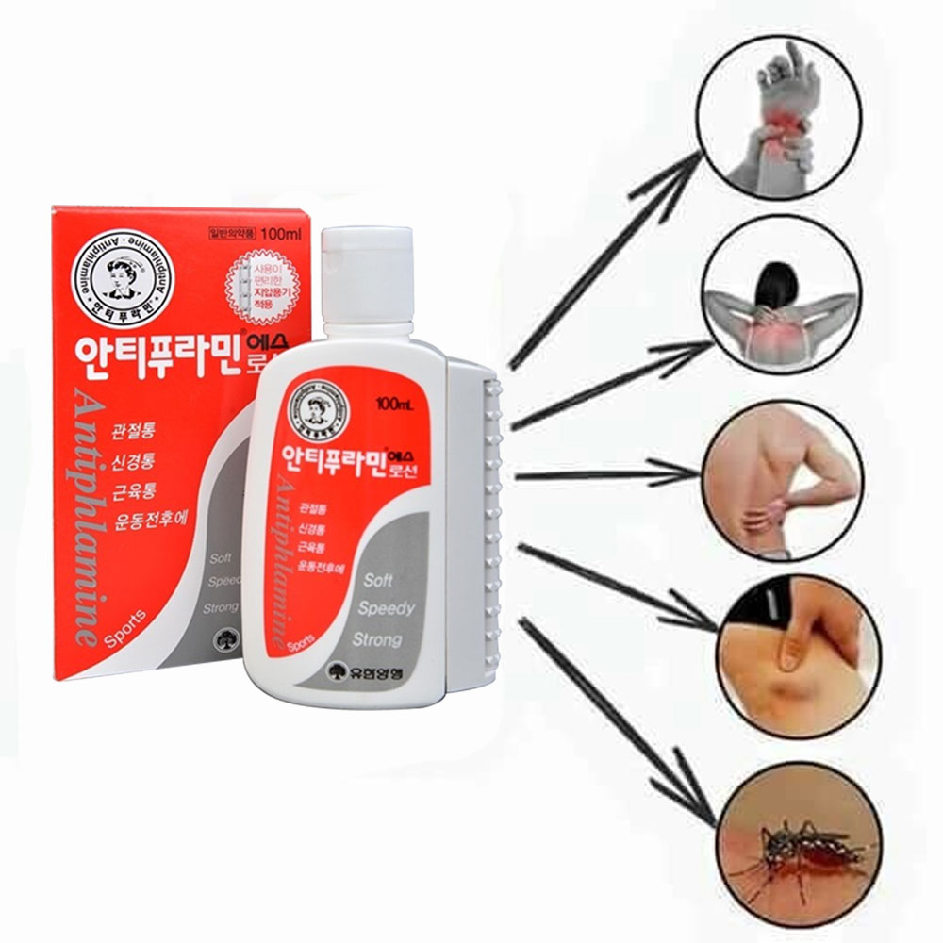
Liniment
/’linimənt/

Slide 14
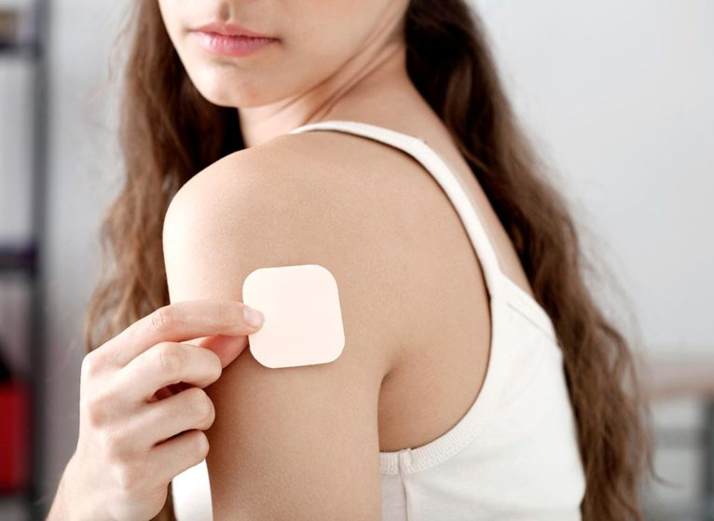
patch:/pætʃ/

Slide 15
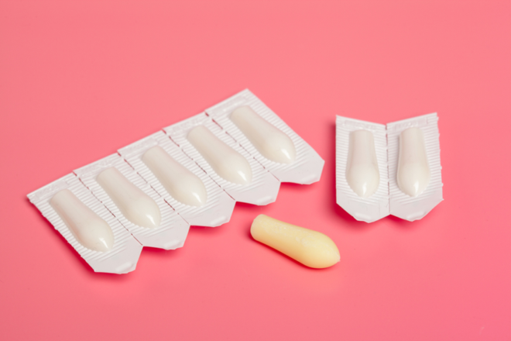
suppository /səˈpɑːzətɔːri/

Slide 16
1. Aerosol
2. tablet
3. Solution
4. ointment
5. Syrup
6. drop
7. Inhaler
8. liniment
9. patch
10.suppository
1-F
A. a small, round piece of medicine to be swallowed without chewing
B. a solid medicine which melts slowly in he rectum or vagina
C. a medication on material or cloth placed on the skin
D. a very small amount of liquid that forms a round shape
E. a small device with medicine to breath in through the mouth/nose
F. a container with a liquid that is administered in spray form
G. an smooth, thick substance to rub on the skin for healing
H. a sweet, liquid medicine taken with a spoon or cup
I. a liquid in which another substance has been dissolved
J. an oily liquid to rub on painful body parts to reduce pain
2-A
3-I
4-G
5-H
6-D
7-E
8-J
9-C
10-B

Slide 17
Ways to get drug?
orally (tablet, syrup, drop)
Injective ( solution)
apply the required area ( patch, liniment)
put into rectum or vagina ( suppository)

Slide 18
Some notes when taking medicine
Read the instruction thoroughly before use
Keep out of reach of children
Store medicine in a cool, dry place.
Keep away from bright light
- Consult your doctors if you encounter with side effects
- Do not take overdose
- Turn on the light and look at the bottle label when taking medicine. ( avoid using the expired medicine)
- Sit or stand when taking medicine, don’t lie down.
- Don’t drink alcohol with your medicines

Slide 19
Giving advice
1. S + should + V
2. S + had better + V
3. It would be advisable/wise+ for sb to + V
Eg: You should stop smoking
=You had better stop smoking
=It would be advisable for you to stop smoking

Slide 20
It would be advisable for you to stay in bed
2. It would be advisable for you to lose a little weight
3. It would be advisable for him to take more exercise
4. It would be advisable for her to discontinue taking those tablets
5. It would be wise for you to stop smoking
6. It would be wise for them to run the tests again
7. It would be wise for you to stop drinking so much
You should/had better stay in bed
You should/had better lose a little weight
He should/had better take more exercise
She should/had better discontinue taking those tablets
You should/had better stop smoking
They should/had better run the tests again
You should/had better stop drinking so much

Slide 21
Ex1-p31: Change into passive
At the moment she is helping the staff nurse
Now they are carrying out sterile procedures
He is showing her the way to the c.s.s.d
They are giving urinals and bedpans to bed-patients
She is assisting the physiotherapist
At the moment, the staff nurse is being helped
Now, sterile procedures are being carried out
She is being shown the way to the cssd
Urinals and bedpans are being given to bed-patients
The physiotherapist is being assisted

Slide 22
6. I’m going to the E.N.T clinic
7. The staff nurse is administering drugs
8. He is fetching the sterile dressing packs
9. A nurse is taking a new patient to the X-ray department
10. A nurse is giving him an intramuscular injection of Pethidine
The E.N.T clinic is being gone to
Drugs are being administered by the staff nurse
The sterile dressing packs are being fetched
A new patient is being taken to the X-ray department by a nurse
He is being given an intramuscular injection of Pethidine by a nurse

Slide 23
Ex2-p32: Put the following sentences into passive
be kept
1. The victim should (keep)…………. warm and comfortable until help arrives
2.When the operation is completed, the patient will (take)……………….…to the orthopedic
3.Body temperature can(measure)……………………..by using a thermometer
4. The patient should(help)………………………….if he vomits
5. Can malaria(prevent)……………………………?
6. Women should(encourage)…………………..to breast feed their infants on demand as often as is feasible
7. Women who use birth control pills should(advise)…………………..........complications that can occur from usage
8. The diarrhea can also(cause)………………………….by parasites or bacteria
9. HIV can also (transmit)…………………… from an infected mother to a child during pregnancy
10. The room must(clean)…………………………right now
be taken
be measured
be helped
be prevented
be encouraged
be advised
be caused
be transmitted
be cleaned

Slide 24
Ex3-p32: Put the verbs in brackets into the correct passive form
be prepared
Before a patient has an operation he should carefully(1. prepare)…………………….for it both mentally and physically. He should be as clean as possible both internally and externally
The night before the operation he should (2. give) ………………………… a warm bath and a day or two earlier, a shampoo. His teeth should (3. brush) ………………………… twice a day and the mouth rinsed with an antiseptic solution three times a day
The patient should (4. not give) …………………………. anything to eat in the morning of the operation, and probably a very small amount of food the night before.
He usually (5. give) ………………………… a warm cleansing enema to empty his colon and just before he goes to the operating theatre he should (6. give) ………………………… a urinal or bedpan to empty his bladder. The area that is to (7. operate) ………………………… on must ………… carefully (8. shave) …………….. These precautions make the operation easier for the surgeon
The patient (9. take) ………………………….. to the operating theatre about twenty minutes before the anesthetic (10. administer) ………………………… His jeweler and dentures (11. remove) …………………………. and labeled with his name.
be given
be brushed
not be given
is…. given
be given
be operated
be
shaven
is taken
is administered
are removed

Slide 25
Ex4-p33: Use each word once to fill in the blanks
hair any operating theatre urine enema ready
surgeon anesthetist antiseptic solution belongings
The patient is taken to the …………………………. ……..for the operation.
2. The patient is operated on by the …………… ……………
3. Patient’s mouth is rinsed with an …………………………
4. The patient should not be given ………………………….food for several hours before the operation.
5. For internal cleanliness an …………………………..is given.
6. The patient should pass …………………………..before.
7. …………………………must be removed from the part of the body to be operated on.
8. The patient should be ………………………….in mind and body for the operation.
9. The anesthetic is administered by the ………………………….
10. The patient’s personal …………………………are removed and labeled
operating theatre
surgeon
antiseptic solution
any
enema
urine
Hair
ready
anesthetist
belongings

Slide 26
Ex5-p33: Rewrite the following sentences as shown
The pharmaceutical company produced a new drug.
2. The surgeon sutured the wound
3. Doctors attend many congress.
4. The professors tell the students to pay attention.
5. They say he is the best surgeon in town.
A new drug was produced by the pharmaceutical company
The wound was sutured by the surgeon
Many congress are attended by doctors
The students are told to pay attention by the professors
He is said to be the best surgeon in town.

Slide 27
6. The nurses are caring for the patients.
7. The biologists are carrying out research.
8. A car knocked the boy down.
9. The doctor will take out the stitches next week.
10. Lack of hygiene causes infection.
The patients are being cared for by the nurses
Research is being carried out by the biologists
The boy was knocked down by a car
The stitches will be taken out by the doctor next week
Infection is caused by lack of hygiene

