Slide 1
UNIT 10: ACTIVITIE
Grammar: Going to

Slide 2
OBJECTIVES
By the end of the lesson, students will be able to
*Knowledge:
1. Use the near future tense with going to in positive, negative and questionable forms
2. Distinguish between a near future (going to) and a single future (will).
*Skills:
3. Ask and answer questions about the near future.
4.Talk about near future plans .
5.Speak about careers in society.
*Learner autonomy and responsibility:
6.Have positive attitude to learn, use English in daily communication.

Slide 3
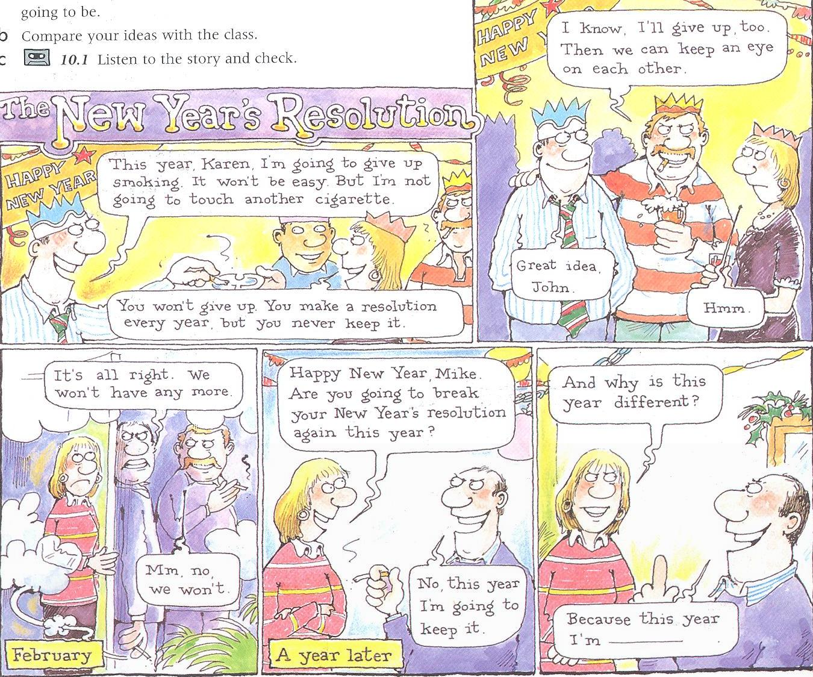
a.Read the story.

Slide 4
* Rules:
1. Look at the cartoon again.
a. Find these forms of going to:
A positive sentence:
A negative sentence:
A question:

Slide 5
* Rules:
b. How do we make these forms of going to ?
Form:
I | am (’m) | going to | watch TV
He / she / it | is (’s) |  | work
We /you / they | are (’re) |  | play tennis
Positive
Negative
I | am not (’m not) | going to | watch TV
He/ she/ it | is not (’s not) |  | work
We/you/ they | are not (’re not ) |  | play tennis

Slide 6
Am | I | going to | watch TV
Is | he/she/it |  | work
Are | we/you/they |  | play tennis
Questions
Short answers
Yes, | I | am
 | he / she /it | is
 | we /you/they | are
No, | I | am not ( ’m not)
 | He / she / it | is not (’s not)
 | we / you / they | are not (aren’t)

Slide 7
2. When do we use going to talk about the future ?
a. Look at these sentences from the story. Say which future form is used and why.
Mike : This year, Karen, I’m going to give up smoking
Karen : You won’t give up smoking.
John : I’ll give up too

Slide 8
b. Use the sentences complete the examples for the rules.
+We use will To make predictions or talk about the future in general. Eg: _______________ When we decide to do something at the moment of speaking Eg:___________ | +We use going to To talk about something that we have already decided to do. Eg: _________________
You won’t stop smoking.
This year, Karen. I’m going to give up smoking.
I’ll give up, too.

Slide 9
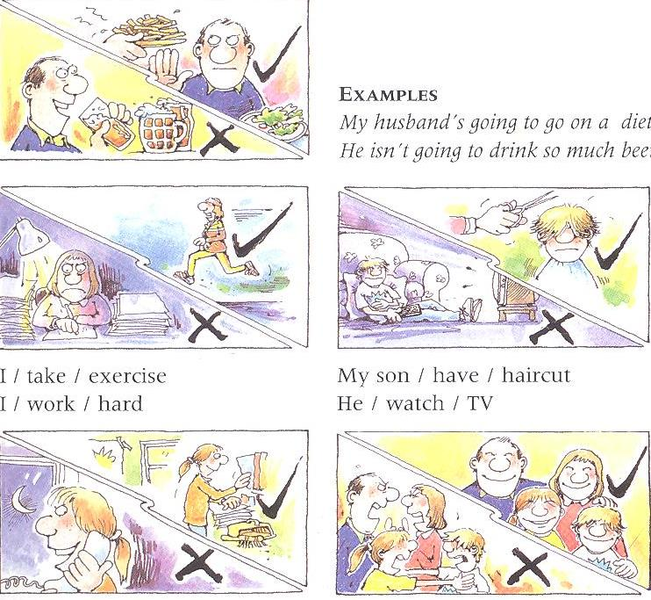
Practice: 1a. Make sentences with going to and this information.
My daughter / tidy / bedroom
She / talk / phone for hours
We / be nicer to each other
We / argue with each other

Slide 10
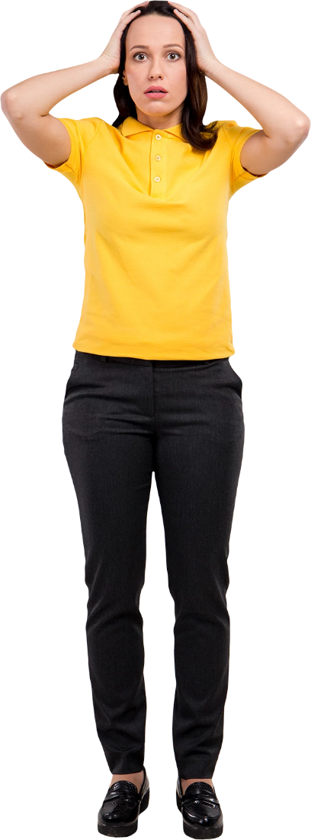
3. Choose the correct future form for each sentence.
John and I are going to / will get married.
2. I’m going to / I’ll help you to look for it.
3. Yes, OK I’m going to / I’ll phone and book a table.
4. I’m going to / I’ll have a bath.
5. Are you going to / will have a party?
6. I’m going to / I’ll get one, too.
7. I’m going to / I’ll read it this evening.
8. You’re going to /you’ll have good luck.

Slide 11
Vocabulary: Gerunds; activities
1.Look at the list of activities. Which do you like doing ?
2.The word in 1 are all gerunds.
a. A gerunds is the – ing form of a verb. How do we make the gerunds of these verbs ?
play
sleep
cycle
shave
skip
knit

Slide 12
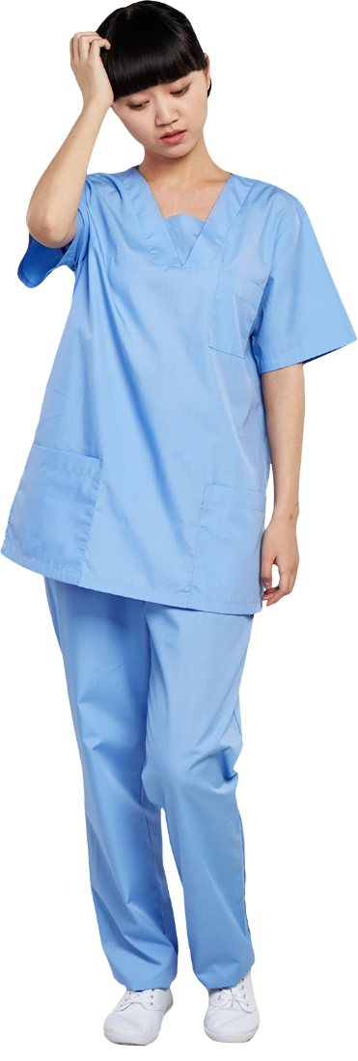
b. What types of gerund are in these sentences?
1.I like swimming
2.She’s very good at swimming
3.Swimming is good for you

Slide 13
Gerunds : * Form
Basis rule
We add – ing to the infinitive.
wash
washing
read
reading
hurry
hurrying
Exceptions:
For verbs that end in –e, we remove the –e and add – ing.
drive
driving
use
using
For the verbs with a short vowel and only one consonant, we double the consonant and add –ing.
Eg: swim
swimming
sit
sitting

Slide 14
* Use
We use gerunds as subjects or objects.
Skiing can be dangerous.
I like traveling by plane
2. We use gerunds following a preposition.
She is very good at swimming.
3. Certain verbal expressions take a gerund.
Would you mind going to the bank for me?
I don’t mind doing that.
Do you fancy watching a video?

Slide 15
3.b. Put the activities above in the correct category.
How many calories can you burn in one hour?
Type of activity | Calories | Examples
-rest -very light activities -light activities -moderate activities -energetic activities -strenuous activities | 60 75 100 100 – 200 200 –400 400 –600 | reading, eating, playing the piano, walking, horse riding, climbing stairs,

Slide 16
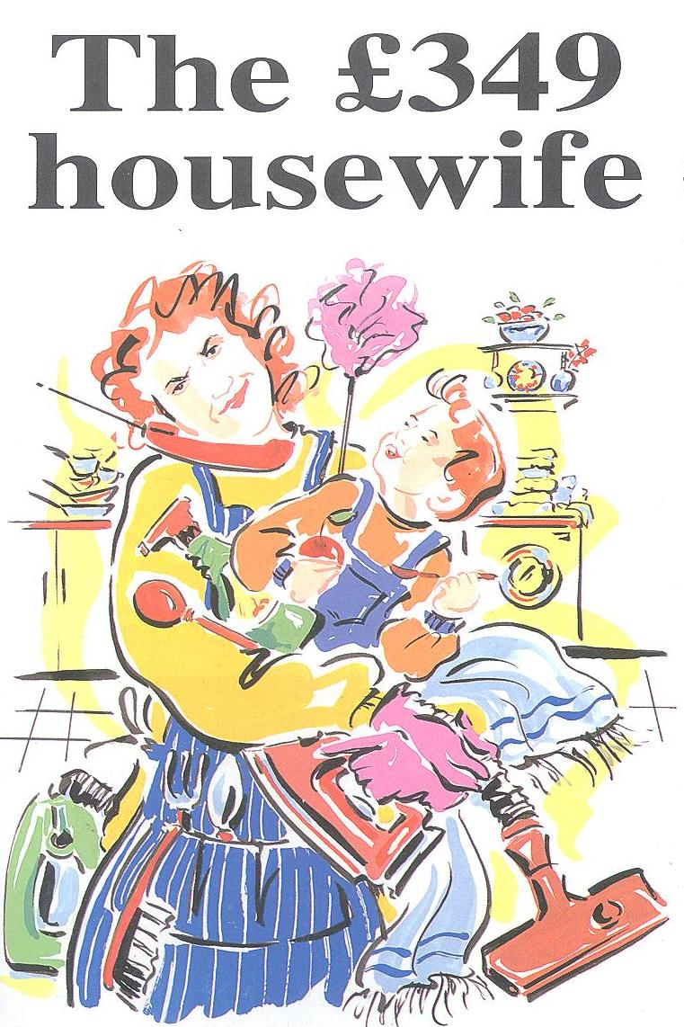
Reading
The 349 housewife
Look at the picture and the headline of the article.
a. What do you think the
article is about?
Notes:
a

Slide 17
b. The first paragraph mentions £349 and 71 hours. What do you think these numbers represent?
d. Find the job for these activities.
activities
job

Slide 18
2. Read the text. Mark these sentences true (v), False (x), don’t know (?).
1. The average housewife works nearly 71 hours
a week.
2. Seventy per cent of the working population
earn 18,000 a year.
3.Train drivers earn the same as prison officer.
4. Teacher earns about 24,000 a years.
5. Looking after children takes up most time.

Slide 19
2. Read the text. Mark these sentences true (v), False (x), don’t know (?).
6. Wives with jobs spend more time on housework
than on their jobs.
7. The average mother with a child under one
works 95 hours a week.
8. Karen Tudor – Williams thinks that the
government should pay women wages.
9. Her husband helps with a lot of the housework.
10. Anne Neale thinks that husbands’ employer
should pay housewives.

Slide 20
Vocabulary file: Work
Find these things in the article:
All the names of jobs:
Five synonyms for work (n) and (v)

Slide 21
two synonyms for pay.
Another way of saying these:
90 hours a week
the hourly cost
housework
it takes a lot of time
the word for the place where someone works.
The abbreviation for do – it - yourself

Slide 22
Listening and speaking
Making suggestions
Loa 10.4
1. Listen and match each conversation with an activity
Conversation 1 Conversation 2 Conversation 3 | visiting relatives going to a restaurant booking a holiday watching a video going to wedding spending a day in the country having a game of tennis planning a party

Slide 23
2a. Tick (√) the activities that the people are going to do.
go to the beach
have a picnic by the river
invite some friend from Spain
telephone Diane and Peter
eat at the Red Dragon restaurant
try the new Italian restaurant
book a table at Mario’s
go to the cinema
hire a video
have a bath
phone the video shop
get some pizzas

Slide 24
Conversation pieces: Expression with –ing forms
a. Complete the expression with the correct forms of the verb go.
* Making suggestions;
How about
What about
Do you fancy
Shall we
Why don’t we
Would you like to
We could
Let’s
for a picnic?
swimming.

Slide 25
* Expression likes/dislikes/preferences:
don’t fancy
don’t mind
I
to the cinema.
I
to the video shop.
I’d rather ____shopping.
Asking people to do things:
Would you mind
Could you
Do you think you could
to the shops for me, please ?

Slide 26
Pronunciation
1./t / and / /; suggestions
a. Listen and tick (v) the word you hear
Loa 10.5
Loa 10.6
watch wash cheap sheep
catch cash chew shoe
chop shop which wish
chip ship choose shoes

Slide 27
2. Making suggestions
c. Mark these suggestions with the correct intonation.
1. Do you fancy going out tonight?
2. Let’s go to the beach.
3. What about getting a video?
4. Shall we book a table at the bistro?
5. Do you want to go to the party?
6.Why don’t we try that new pub?
7. I fancy seeing a film tonight
8. How about spending a week in Rio?

